Slide 1
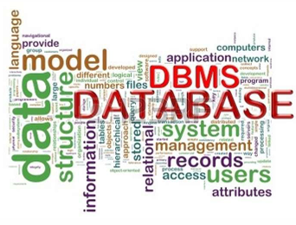
Advanced Database Management
(Advanced DBM)
(ITec3071)
The most useful Resources for this chapter:-
1. National open university of Nigeria, course code: CIT 905,
course title: advanced database management system (from page 66-94)
2. Fundamentals of Database Systems. By:- Ramez Elmasri and Shamkant B. Navathe, 7th edition (part 8,chapter 18 and 19)

Slide 2
CHAPTER ONE
Query Processing and Optimization

Slide 3
Chapter Outline
Translating SQL Queries into Relational Algebra
Basic Algorithms for Executing Query Operations
Using Heuristic in Query Optimization
Using Selectivity and Cost Estimates in Query Optimization
Semantic Query Optimization

Slide 4

What is Relational Algebra?
Relational Algebra: refers to a procedural query language that takes relation instances as input and returns relation instances as output.
It performs queries with the help of operators.
A binary or unary operator can be used.
Also, basic set of operations for the relational model is known as the relational algebra. These operations enable a user to specify basic retrieval requests.
The result of retrieval is a new relation, which may have been formed from one or more relations.
The algebra operations thus produce new relations, which can be further manipulated using operations of the same algebra.

Slide 5
Translating SQL Queries into Relational Algebra
Query block
The basic unit that can be translated into the algebraic operators and optimized.
A query block contains a single SELECT-FROM-WHERE expression, as well as GROUP BY and HAVING clause if these are part of the block.
Nested queries within a query are identified as separate query blocks.
Aggregate operators in SQL must be included in the extended algebra

Slide 6
Basic Mapping Rules
SQL Component | Relational Algebra(RA) Operation
SELECT (columns) | Projection (π)
FROM (tables) | Cartesian Product (×) or Join (⋈)
WHERE (row condition) | Selection (σ)
JOIN ... ON | Join (⋈)
UNION | Union (∪)
EXCEPT | Set Difference (−)
INTERSECT | Intersection (∩)
DISTINCT | Duplicate elimination (δ)
GROUP BY + Aggregates | Extended RA (γ)

Slide 7
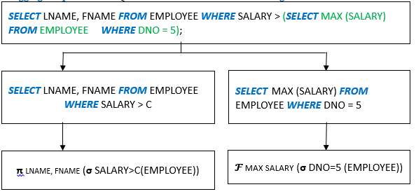
Translating SQL Queries into Relational Algebra
Example:

Slide 8

Translating SQL Queries into Relational Algebra
Relational Algebra consists of several groups of operations
I. Unary Relational Operations
    PROJECT (symbol: π (pi))
    SELECT (symbol: σ (sigma))
    RENAME (symbol: ρ (rho))
    II. Relational Algebra Operations from Set Theory
    UNION (∪), INTERSECTION (∩), DIFFERENCE (or MINUS, –)
CARTESIAN PRODUCT (X)

Slide 9
Translating SQL Queries into Relational Algebra
    III. Binary Relational Operations
    JOIN (several variations of JOIN exist like OUTER JOINS, OUTER UNION)
    DIVISION
    IV. Additional Relational Operations
    AGGREGATE FUNCTIONS (These compute summary of information: for example, SUM, COUNT, AVG, MIN, MAX)

Slide 10
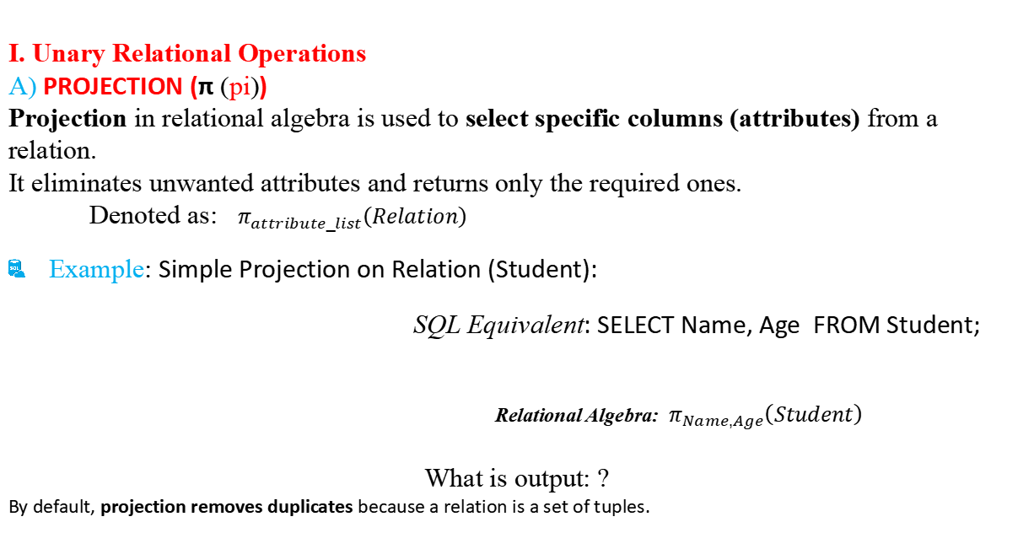
Translating SQL Queries into Relational Algebra
I. Unary Relational Operations
A) PROJECTION (π (pi))
Projection in relational algebra is used to select specific columns (attributes) from a relation.
It eliminates unwanted attributes and returns only the required ones.
Denoted as: $π_{attribute_list}\left(Relation\right)$
    Example: Simple Projection on Relation (Student):
    SQL Equivalent: SELECT Name, Age FROM Student;
Relational Algebra: $π_{Name,Age}\left(Student\right)$
What is output: ?
By default, projection removes duplicates because a relation is a set of tuples.
Stu_ID | Name | Age | Dept
101 | Abel | 21 | CS
102 | Haniel | 20 | IT
103 | Samuel | 22 | CS

Slide 11
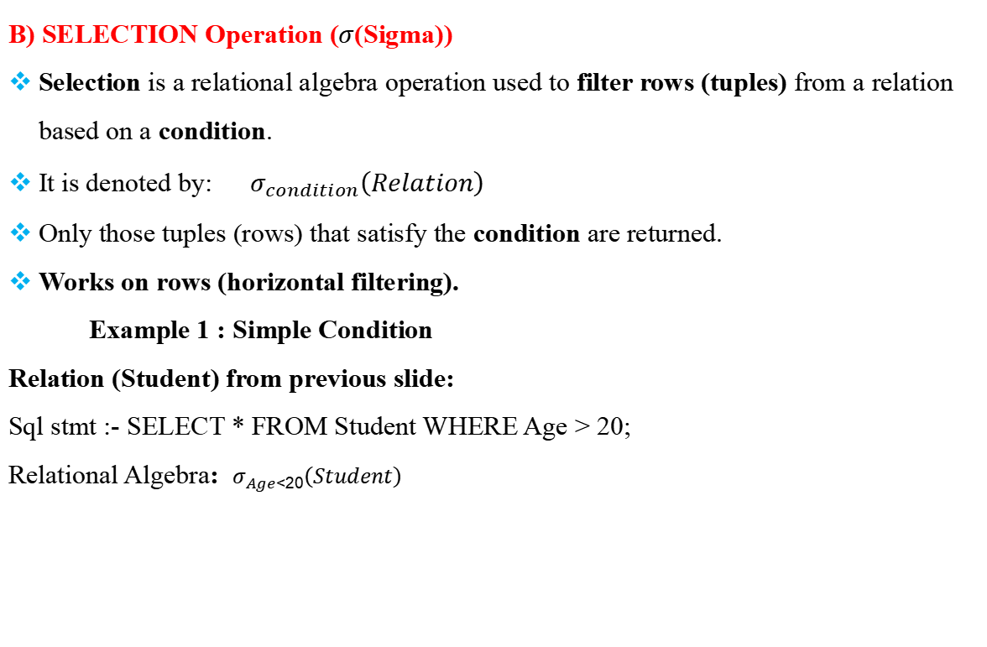
Translating SQL Queries into Relational Algebra
    B) SELECTION Operation ($σ$(Sigma))
Selection is a relational algebra operation used to filter rows (tuples) from a relation based on a condition.
It is denoted by: $σ_{condition}\left(Relation\right)$
Only those tuples (rows) that satisfy the condition are returned.
Works on rows (horizontal filtering).
Example 1 : Simple Condition
Relation (Student) from previous slide:
Sql stmt :- SELECT * FROM Student WHERE Age > 20;
Relational Algebra: $σ_{Age>20}\left(Student\right)$

Slide 12
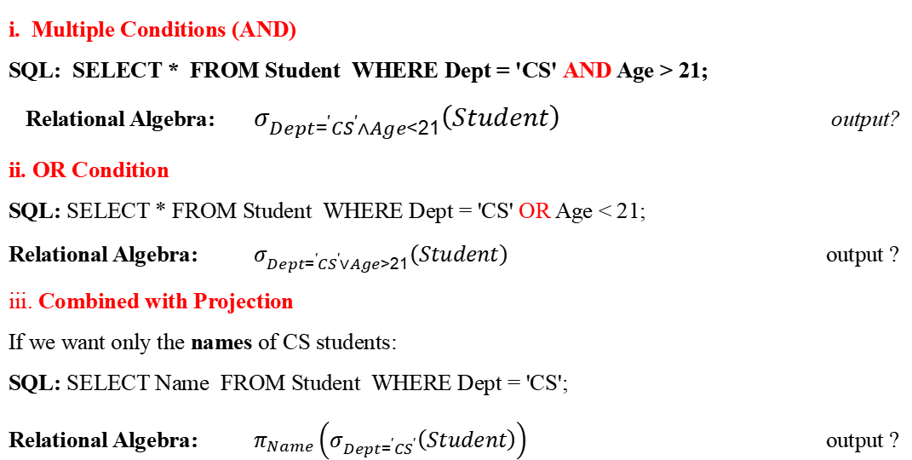
Translating SQL Queries into Relational Algebra
i. Multiple Conditions (AND)
SQL: SELECT * FROM Student WHERE Dept = 'CS' AND Age > 21;
Relational Algebra: $σ_{Dept=^{′}CS^{′}∧Age>21}\left(Student\right)$ output?
ii. OR Condition
SQL: SELECT * FROM Student WHERE Dept = 'CS' OR Age < 21;
Relational Algebra: $σ_{Dept=^{′}CS^{′}∨Age<21}\left(Student\right)$ output ?
iii. Combined with Projection
If we want only the names of CS students:
SQL: SELECT Name FROM Student WHERE Dept = 'CS';
Relational Algebra: $π_{Name}\left(σ_{Dept=^{′}CS^{′}}\left(Student\right)\right)$ output ?

Slide 13

Translating SQL Queries into Relational Algebra
    What is the SQL statement of the above relational operations?
    SELECT * FROM EMPLOYEE WHERE DNO=”4” AND SALARY>30000;

Slide 14
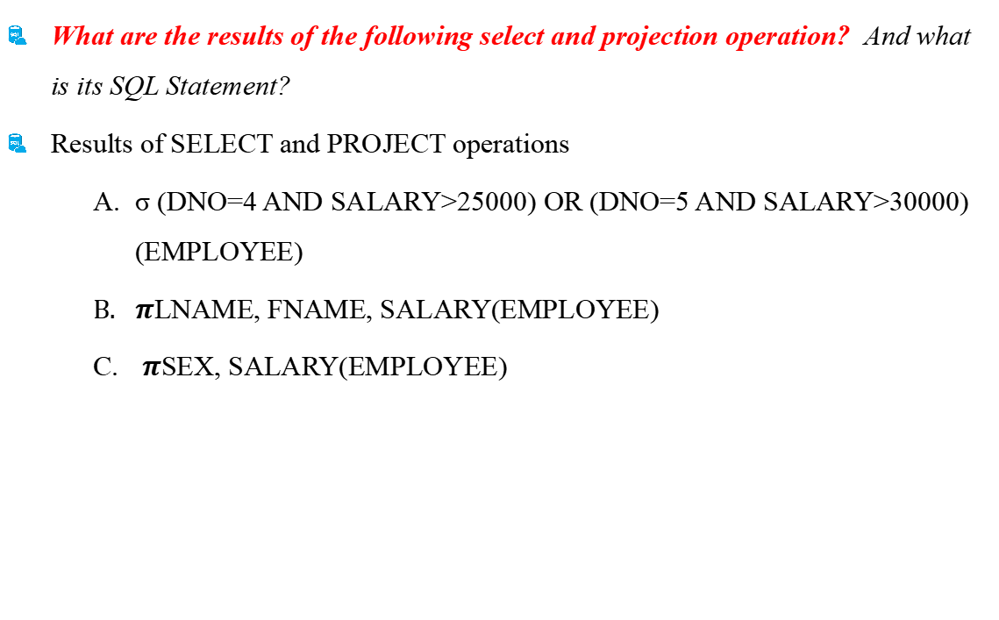
Translating SQL Queries into Relational Algebra
    What are the results of the following select and projection operation? And what is its SQL Statement?
    Results of SELECT and PROJECT operations
        σ (DNO=4 AND SALARY>25000) OR (DNO=5 AND SALARY>30000) (EMPLOYEE)
        $π$LNAME, FNAME, SALARY(EMPLOYEE)
        $π$SEX, SALARY(EMPLOYEE)

Slide 15
Translating SQL Queries into Relational Algebra
    What are the results of the following select and projection operation? And what is its SQL Statement?
    The SQL statement of the above relational algebra is the following.
  SELECT * FROM EMPLOYEE WHERE DNO='4' AND SALARY>2500 OR DNO='5' AND SALARY>30000;
  SELECT FIRSTNAME, LASTNAME, SALARY FROM EMPLOYEE;
  SELECT SEX, SALARY FROM EMPLOYEE;

Slide 16
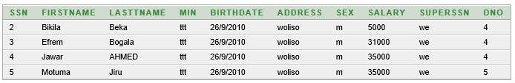
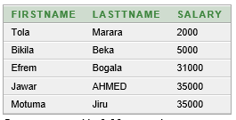
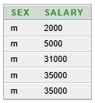
Translating SQL Queries into Relational Algebra
    The result of the above SQL statement is:

Slide 17
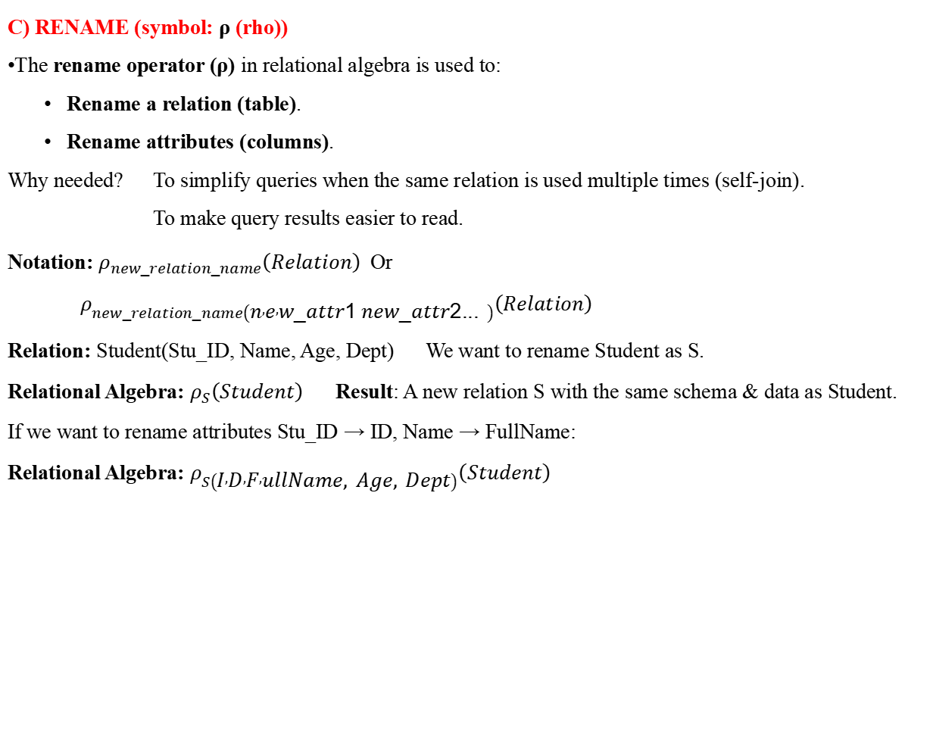
Translating SQL Queries into Relational Algebra
    C) RENAME (symbol: ρ (rho))
The rename operator (ρ) in relational algebra is used to:
  Rename a relation (table).
  Rename attributes (columns).
Why needed? To simplify queries when the same relation is used multiple times (self-join).
  To make query results easier to read.
Notation: $ρ_{new_relation_name}\left(Relation\right)$Or $ρ_{new_relation_name\left(n , e , w_attr1 new_attr2...\right)}\left(Relation\right)$
Relation: Student(Stu_ID, Name, Age, Dept) We want to rename Student as S.
Relational Algebra: $ρ_{S}\left(Student\right)$ Result: A new relation S with the same schema & data as Student.
If we want to rename attributes Stu_ID → ID, Name → FullName:
Relational Algebra: $ρ_{S\left(I , D , F , ullName, Age, Dept\right)}\left(Student\right)$

Slide 18
Translating SQL Queries into Relational Algebra
    2) Relational Algebra Operations from Set Theory
    A) UNION OPERATION
    The result of this operation, denoted by RUS is a relation that includes all tuples that are either in R or in S or in both R and S.
    Duplicate tuples is eliminated.
    Type Compatability
    Type Compatibility of operands is required for the binary set operation UNION ∪, (also for INTERSECTION ∩, and SET DIFFERENCE –
    R1(A1, A2, ..., An) and R2(B1, B2, ..., Bn) are type compatible if:
    They have the same number of attributes, and
    The domains of corresponding attributes are type compatible (i.e. dom(Ai)=dom(Bi) for i=1, 2, ..., n).

Slide 19


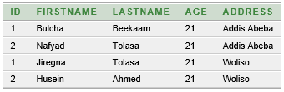
Translating SQL Queries into Relational Algebra
    Example:
Instructor Student
Instructor U Student
SQL Command: SELECT * FROM student UNION ALL SELECT * FROM instructor;

Slide 20
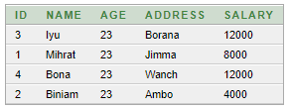



Translating SQL Queries into Relational Algebra
    B) INTERSECTION OPERATION
    The result of this operation denoted by R n S is a relation that includes all tuples that are in both R and S.
    The two operands must be "type compatible “.
          Customers Customer
Customers
Customer

Slide 21
Translating SQL Queries into Relational Algebra
    C) Set Difference (or MINUS) Operation
    The result of this operation, denoted by R - S, is a relation that includes all tuples that are in R but not in S.
    The two operands must be "type compatible”.
        Note: both union and intersection are commutative operations; i.e. RUS=SUR and R n S = S n R
    The minus operation is not commutative, that is in general. R-S? S-R
    D) CARTESIAN (or cross product) Operation
    This operation is used to combine tuples from two relations in a combinational fashion.
    In general, the result of R(A1, A2,….An) x S(B1, B2,….,Bm) is a relation Q with degree n+m attributes Q(A1, A2,….An, B1, B2,….,Bm), in that order.
    The resulting relation Q has one tuple for each combination of tuples—one from R and one from S.

Slide 22
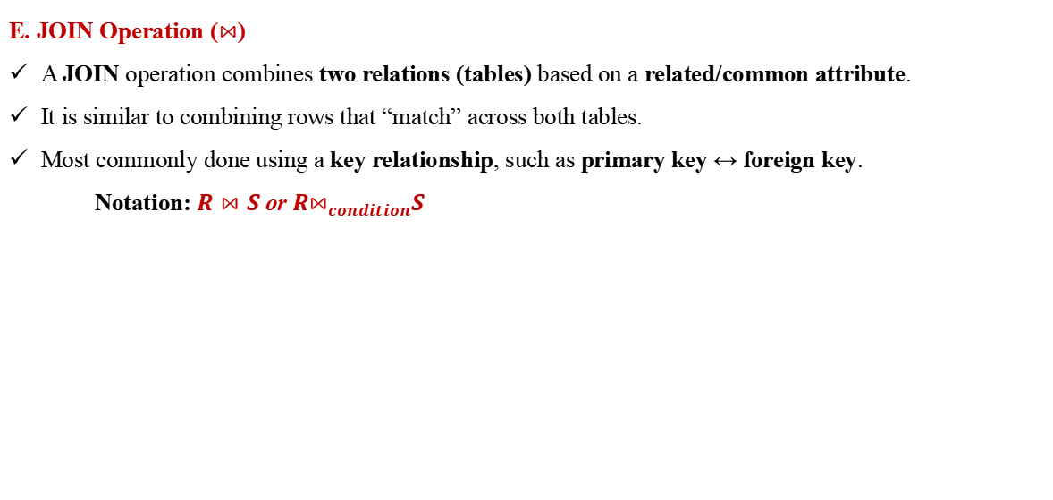
Translating SQL Queries into Relational Algebra
E. JOIN Operation ($⋈$)
A JOIN operation combines two relations (tables) based on a related/common attribute.
It is similar to combining rows that “match” across both tables.
Most commonly done using a key relationship, such as primary key ↔ foreign key.
Notation: $R⋈S \text{or} R⋈_{condition}S$
Join Type | Symbol / Notation | Meaning
Theta Join | ( R ⋈{condition} S ) | Join with any condition (>, <, =)
Equi Join | ( R ⋈{R.A = S.B} S ) | Condition only uses =
Natural Join | ( R ⋈ S ) | Join on all common attributes (automatic)
Outer Join (not core relational algebra but extended) | Left / Right / Full | Keeps non-matching rows also

Slide 23
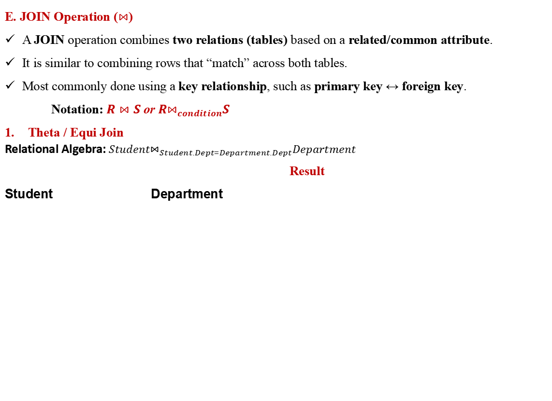
Translating SQL Queries into Relational Algebra
E. JOIN Operation ($⋈$)
A JOIN operation combines two relations (tables) based on a related/common attribute.
It is similar to combining rows that “match” across both tables.
Most commonly done using a key relationship, such as primary key ↔ foreign key.
Notation: $R⋈S \text{or} R⋈_{condition}S$
Theta / Equi Join
Relational Algebra: $Student⋈_{Student.Dept=Department.Dept}Department$
                Result
Student Department
SQL Equivalent:
SELECT *
FROM Student
JOIN Department
ON Student.Dept = Department.Dept;
Stu_ID | Name | Dept | HOD
101 | Abel | CS | Dr. John
102 | Hana | IT | Dr. Mary
103 | Samuel | CS | Dr. John
Stu_ID | Name | Dept
101 | Abel | CS
102 | Hana | IT
103 | Samuel | CS
Dept | HOD
CS | Dr. John
IT | Dr. Mary

Slide 24
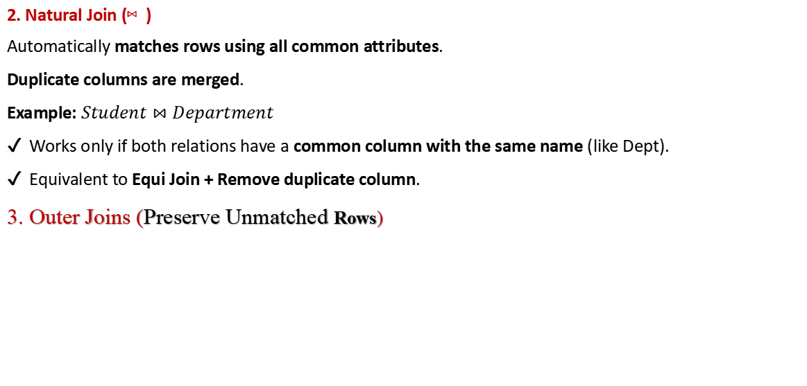
Translating SQL Queries into Relational Algebra
2. Natural Join (⋈)
Automatically matches rows using all common attributes.
Duplicate columns are merged.
Example: $Student⋈Department$
✔ Works only if both relations have a common column with the same name (like Dept).
✔ Equivalent to Equi Join + Remove duplicate column.
3. Outer Joins (Preserve Unmatched Rows)
Type | Symbol | SQL | Meaning
Left Outer Join | R ⟕ S | LEFT JOIN | Keep all rows from Left (R), even if no match
Right Outer Join | R ⟖ S | RIGHT JOIN | Keep all rows from Right (S)
Full Outer Join | R ⟗ S | FULL JOIN | Keep all rows from both sides

Slide 25
What is Query Processing?
Query Processing is the process of translating a high-level query, such as SQL, into a low-level query that can be executed by the database system.
This involves parsing, validating, and optimizing the query, as well as generating a query execution plan.
A query execution plan is a sequence of operations that the database system performs to retrieve the data requested by the query.
An important aspect of query processing is query optimization.
What is the aim of query processing?

Slide 26
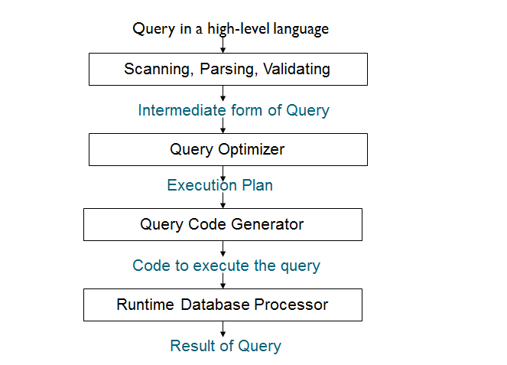
Steps in Processing High-Level Query

Slide 27
Cont’d...
Scanner: The scanner identifies the language tokens such as SQL Keywords, attribute names, and relation names in the text of the query.
Parser: The parser checks the query syntax to determine whether it is formulated according to the syntax rules (rules of grammar) of the query language.
Validation: The query must be validated by checking that all attributes and relation names are valid and semantically meaningful names in the schema of the particular database being queried.
Query Optimization: The process of choosing a suitable execution strategy for processing a query. This module has the task of producing an execution plan.
Query Code Generator: It generates the code to execute the plan.
Runtime Database Processor: It has the task of running the query code whether in compiled or interpreted mode. If a runtime error results an error message is generated by the runtime database processor.

Slide 28
Processing can be....
Processing can be divided into Decomposition, Optimization, Execution, and Code generation.
Query Decomposition:-
It is the process of transforming a high-level query into a relational algebra query, and to check that the query is syntactically and semantically correct.
It Consists of parsing and validation
Typical stages in query decomposition are:
1. Analysis:
2. Normalization:
3. Semantic Analysis
4. Simplification

Slide 29
Processing can be....
3. Semantic Analysis
This step checks meaning-based correctness, such as type compatibility, constraints, permissions, etc.
Example: it checks:
Only logically valid queries proceed.
1. Analysis (Parsing & Validation)
The DBMS checks syntax and verifies table/column names.
If you wrote something like:
SELECT SName FROM Students WHERE Dept = 'CS';
It checks:
Does table Students exist?
Does column SName exist?
Is the SQL syntax valid?
2. Normalization
Convert the query into a standard / canonical relational algebra form.
Break complex conditions into simpler components.
Example:
SELECT Name FROM Student WHERE NOT (Dept != 'CS' OR Age < 18);
Normalize using De Morgan’s Law:
Dept = 'CS' AND Age >= 18
Condition | Semantic Error?
WHERE Age = 'CS' | ❌ Age is numeric, 'CS' is string
WHERE Salary > 100 but column is VARCHAR | ❌ Type mismatch
Accessing a column user has no permission on | ❌ Authorization failure
4. Simplification
DBMS removes redundant conditions and simplifies expressions.
Example:
WHERE Dept = 'CS' AND (Dept = 'CS' OR Age > 20)
Simplified to:
WHERE Dept = 'CS'

Slide 30
What is Query Optimization?
Query optimization is the process of finding the best query execution plan for a given query, based on various factors such as the schema, the data, the indexes, the statistics, and the system resources.
Query optimization aims to minimize the cost of executing the query, which can be measured by the time, the disk I/O, the memory usage, or the network traffic.

Slide 31
Query Optimization
Problem of query optimization is to find the sequence of steps that produces the answer to user request in the most efficient manner, given the database structure.
The performance of a query is affected by:-
  the tables or queries that underlies the query,
  the complexity of the query.
Given a request for data manipulation or retrieval, an optimizer will choose an optimal plan for evaluating the request from among the manifold alternative strategies. i.e. there are many ways (access paths) for accessing desired file/record.

Slide 32
Reading Assignment
What are Transformational rules for relational Algebra?
Reference:- Fundamentals of Database Systems
SIXTH EDITION (page 706 -711)
by:- Ramez Elmasri and Shamkant B. Navathe

Slide 33
Techniques for Query Optimization
Two main Techniques for Query Optimization:
1.Heuristic Rules: -Rules for ordering the operations in query optimization.
2. Cost-Based Optimization(Using Selectivity & Cost Estimates) : -It estimates cost of different execution strategies and chooses the execution plan with lowest execution cost.

Slide 34
Heuristic Query Tree Optimization
The heuristic query optimizer will transform initial query tree into an equivalent final query tree that is efficient to execute.The optimizer must include rules for equivalence among relational algebra expressions that can be applied to transform the initial tree into the final, optimized query tree.
Processes/steps for heuristics optimization:
1. Break up SELECT operations with conjunctive conditions into a cascade of SELECT operations
2. Using the commutativity of SELECT with other operations, move each SELECT operation as far down the query tree as is permitted by the attributes involved in the select condition
3. Using commutativity and associativity of binary operations, rearrange the leaf nodes of the tree

Slide 35
Cont’d...
4. Combine a CARTESIAN PRODUCT operation with a subsequent SELECT operation in the tree into a JOIN operation, if the condition represents a join condition
5. Using the cascading of PROJECT and the commuting of PROJECT with other operations, break down and move lists of projection attributes down the tree as far as possible by creating new PROJECT operations as needed
6. Identify sub-trees that represent groups of operations that can be executed by a single algorithm

Slide 36
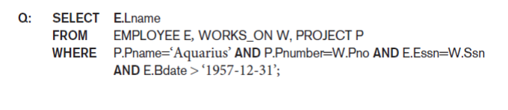
Query tree:
Query tree:
A tree data structure that corresponds to a relational algebra expression. It represents the input relations of the query as leaf nodes of the tree, and represents the relational algebra operations as internal nodes.
Example: Query : "Find the last names of employees born after 1957 who work on a project named
‗Aquarius‘."
Notes:
A query tree is used to represent a rela_x0002_tional algebra or extended relational algebra expression, whereas a query graph is
used to represent a relational calculus expression.,

Slide 37
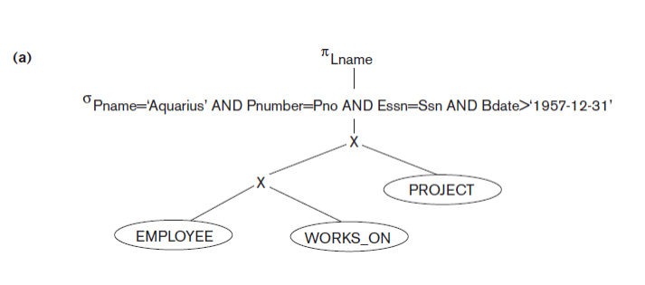
Steps:1 Steps in converting a query tree during heuristic optimization. (a) Initial (canonical) query tree for SQL query Q.

Slide 38
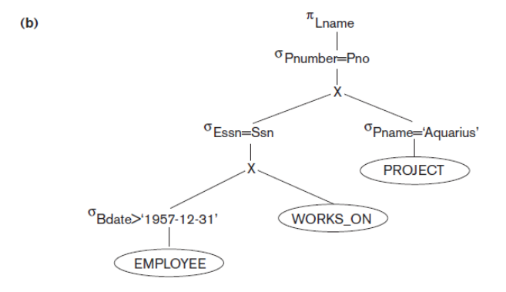
Step 2: converting a query tree during heuristic optimization
(b) Moving SELECT operations down the query tree.

Slide 39
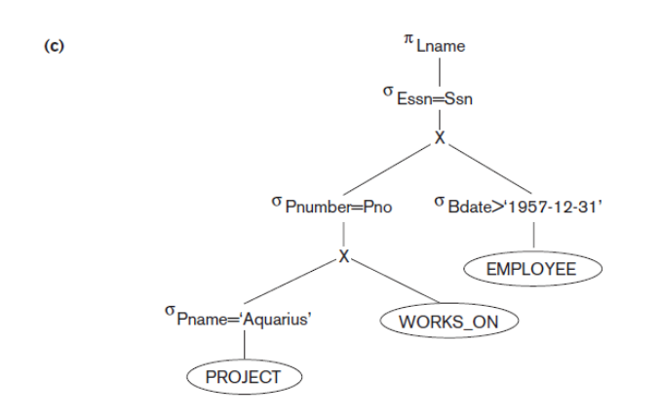
Step 3: converting a query tree during heuristic optimization
(c) Applying the more restrictive SELECT operation first.

Slide 40
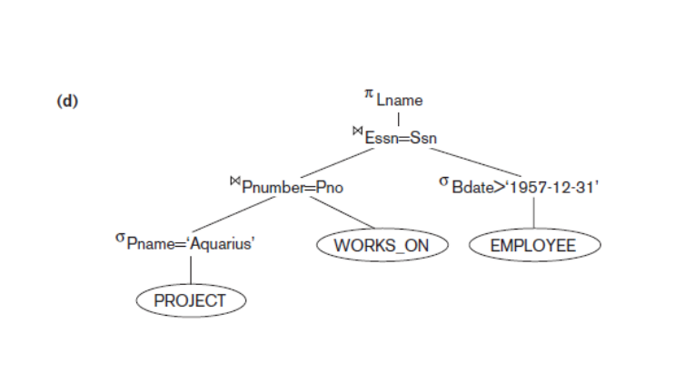
Step 4: converting a query tree during heuristic optimization
(d) Replacing CARTESIAN PRODUCT and SELECT with JOIN operations.

Slide 41
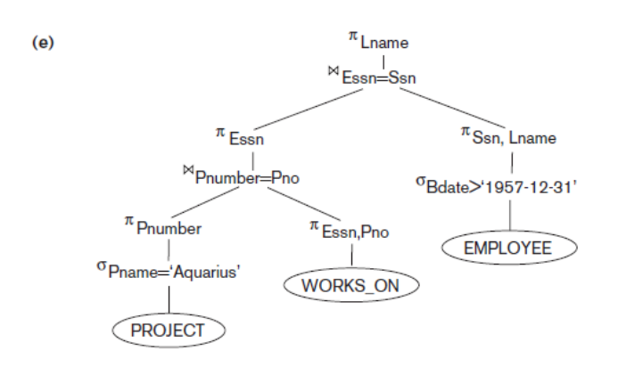
Step 5: converting a query tree during heuristic optimization
(e) Moving PROJECT operations down the query tree

Slide 42
Query graph
Query graph:
A graph data structure that corresponds to a relational calculus expression. It does not indicate an order on which operations to perform first.
Nodes represent Relations.
Ovals/Double circles represent constant nodes.
Edges represent Join & Selection conditions.
Attributes to be retrieved from relations represented in square brackets.
Drawback: - Does not indicate an order on which operations are performed first.
There is only a single graph corresponding to each query.

Slide 43
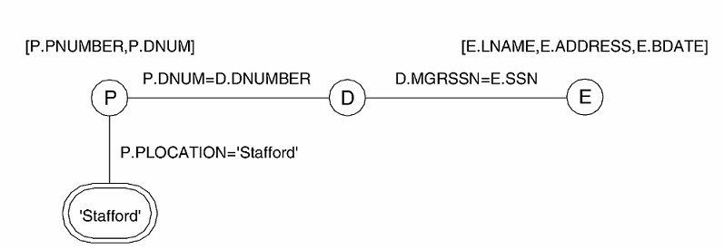
Cont’d...

Slide 44
Cost-Based Optimization(CBO)
Using Selectivity & Cost Estimates
Cost-Based Optimization is a method used by the DBMS query optimizer to choose the best (fastest) execution plan based on:
Factor | Meaning
Selectivity | How many rows match a condition
I/O Cost | Disk reads required
CPU Cost | Time taken to process data
Available Indexes | Can we quickly search?
Join Methods | Which algorithm is better?
SQL query:-
SELECT S.Name, D.HOD
FROM Students S, Departments D
WHERE S.Dept = D.DeptID AND S.Dept = 'CS';
Example Scenario
Table | Rows | Indexed Column
Students | 10,000 | Dept
Departments | 100 | DeptID
Notes:
The Optimizer determines the most efficient execution plan for each SQL statement based on the structure of the query, the available statistical information about the underlying objects, and all the relevant optimizer and execution features

Slide 45
CBO…
Step 1: Estimate Selectivity
Total students = 10,000
Suppose 10% are CS students → 1000 rows match
Selectivity = 1000 / 10,000 = 0.1 (10%)
Step 2: Consider Two Possible Plans
Plan | Method | Estimated Cost
Plan A | Full Table Scan on Students + Join | Read 10,000 rows
Plan B | Index Scan on Students(Dept) → Fetch only CS rows + Join | Read 1,000 rows
Step 3: Choose Best Join Strategy
Join Method | Cost | Best When
Nested Loop Join | High | Small tables
Hash Join | Medium | No index, large tables
Merge Join | Low | Both sides sorted or indexed
Since DeptID in Departments is indexed, and filtered Students = 1,000 rows, the optimizer chooses:
Index Nested Loop Join → Lowest Cost!

Slide 46

How Cost is Calculated in Query Optimization
The DBMS assigns a numeric value (cost) to different query execution strategies based on Disk I/O + CPU operations.
3. Cost Example — Selection Query
Query:
SELECT * FROM Students WHERE Dept = 'CS’;
Case
1: No Index → Full Table Scan
Pages = 100Cost = Read all 100 pages
Case
2: With Index on Dept:
Suppose only 10% students are CS (1000 rows → 10 pages)
Index Lookup Cost ≈ 2 pages
Fetch matching rows ≈ 10 pages
Total Cost = 2 + 10 = 12 pages
Optimizer chooses index plan (12 < 100)
1. Basic Cost Formula
Most DBMS optimizers use a simplified formula:
$$\text{Total} \text{Cost}=\text{Disk} \text{I}\text{/}\text{O} \text{Cost}+\text{CPU} \text{Cost}$$
However, Disk I/O is usually dominant, so:
$$\text{Cost}≈\text{Number} \text{of} \text{Disk} \text{Page} \text{Reads}$$
2. Estimating Disk Pages
A table is stored in pages/blocks. For example:
If each page stores 100 rows
And your table has 10,000 rows
Then Pages = 10000 / 100 = 100 pages

Slide 47
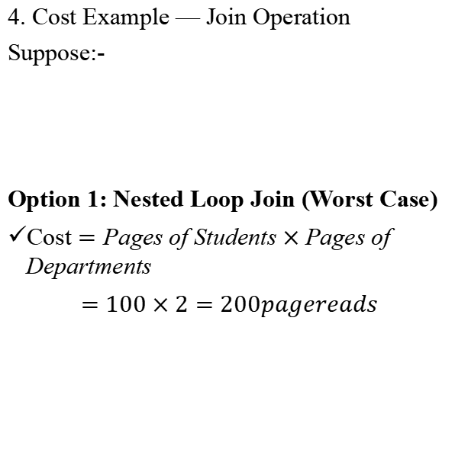
CBO…
4. Cost Example — Join Operation
Suppose:-
Option 1: Nested Loop Join (Worst Case)
$\text{Cost}=\text{Pages} \text{of} \text{Students}×\text{Pages} \text{of} \text{Departments}$
$=100×2=200pagereads$
Option 2: Index Nested Loop Join
If DeptID in Departments is indexed:
"Cost"="Pages of Students"+("Rows of Students" ×"Index Lookup Cost" )
Assuming 10,000 students, each index lookup = 1 page
100+(10ⓜ,000×1/100)≈200𝑝𝑎𝑔𝑒𝑠
(If selectivity is used to reduce rows first; cost becomes much lower!)
Table | Pages
Students | 100 pages
Departments | 2 pages

Slide 48
Semantic Query Optimization:
Uses constraints specified on the database schema in order to modify one query into another query that is more efficient to execute.
Consider the following SQL query, SELECT E. LNAME, M. LNAME FROM EMPLOYEE E M WHERE E. SUPERSSN=M.SSN AND E. SALARY>M.SALARY
Explanation:
Suppose that we had a constraint on the database schema that stated that no employee can earn more than his or her direct supervisor.
If the semantic query optimizer checks for the existence of this constraint, it need not execute the query at all because it knows that the result of the query will be empty. Techniques known as theorem proving can be used for this purpose.

Slide 49
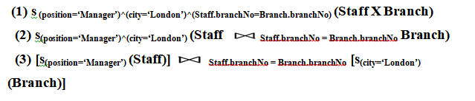
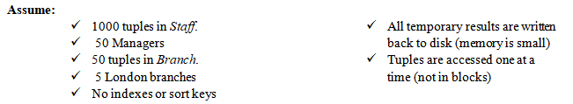
Exersice (5%)
Examples for query Optimization: Identify all managers who work in a London branch
SQL: - SELECT * FROM Staff s, Branch b WHERE s.branchNo = b.branchNo AND s.position = ‘Manager’ AND b.city = ‘london’;
Results in these equivalent relational algebra statements

Slide 50
END OF CHAPTER ONE

